Slide 1


Managing your bibliography with

Slide 2
Agenda
Why Zotero?
Principles
Installing
Capturing
Managing
Writing
Sharing with others
Shortcomings and remedies
Questions?

Slide 3
Why Zotero?
Free software
Works on Windows, Mac OS X, Linux
Works with Firefox, Chrome, Safari, Opera
Plugs into Microsoft Word (Windows or Mac) and LibreOffice Writer
Includes 300MB of free cloud storage, you can ‘rent’ larger cloud storage plans from Zotero
Allows you to create shared libraries to share or manage a bibliography with others
Created and maintained by Center for History and New Media, George Mason University (non-commercial)

Slide 4


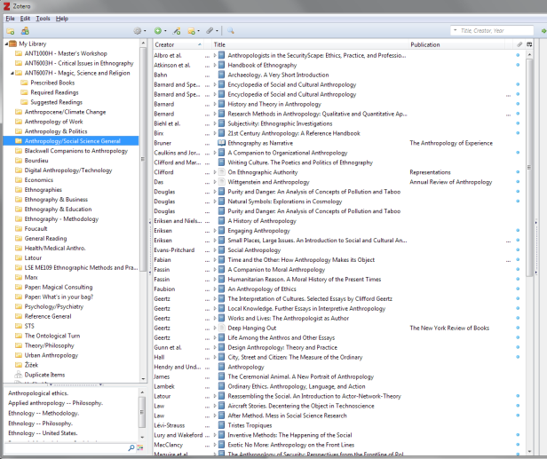
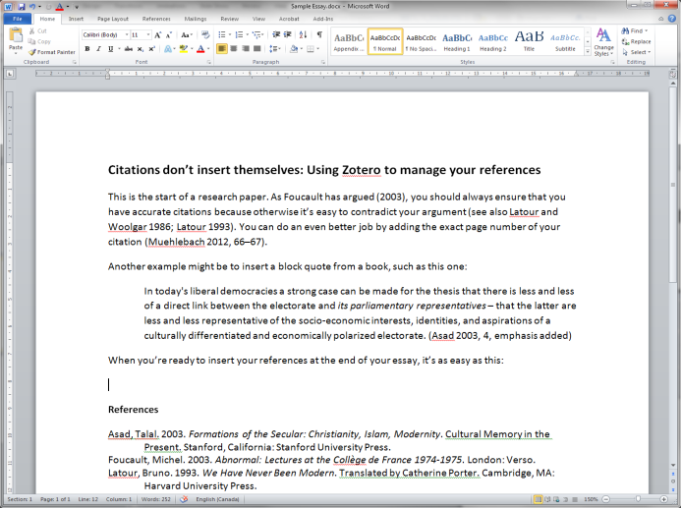
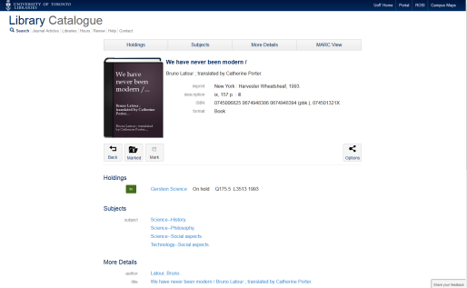
Principles
One continuous workflow
Find it
Capture it
Insert citations
Insert bibliography
Manage it

Slide 5
Installing
http://www.zotero.org
Two different versions:
  A Firefox version (works inside the browser)
  A standalone version
I recommend standalone (gives you more options)

Slide 6
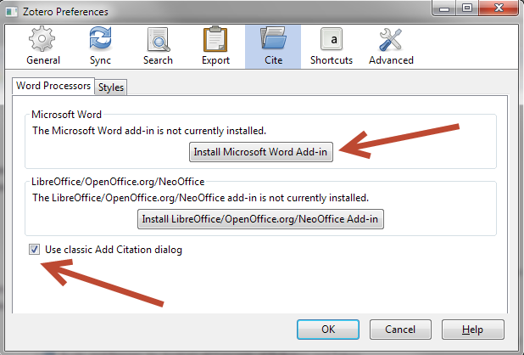
Configuration
In Zotero (standalone), under Zotero, Preferences (Mac) or Tools, Preferences (Windows)
  Install the Word Add-On
  Turn on “Use classic Add Citation dialog”

Slide 7
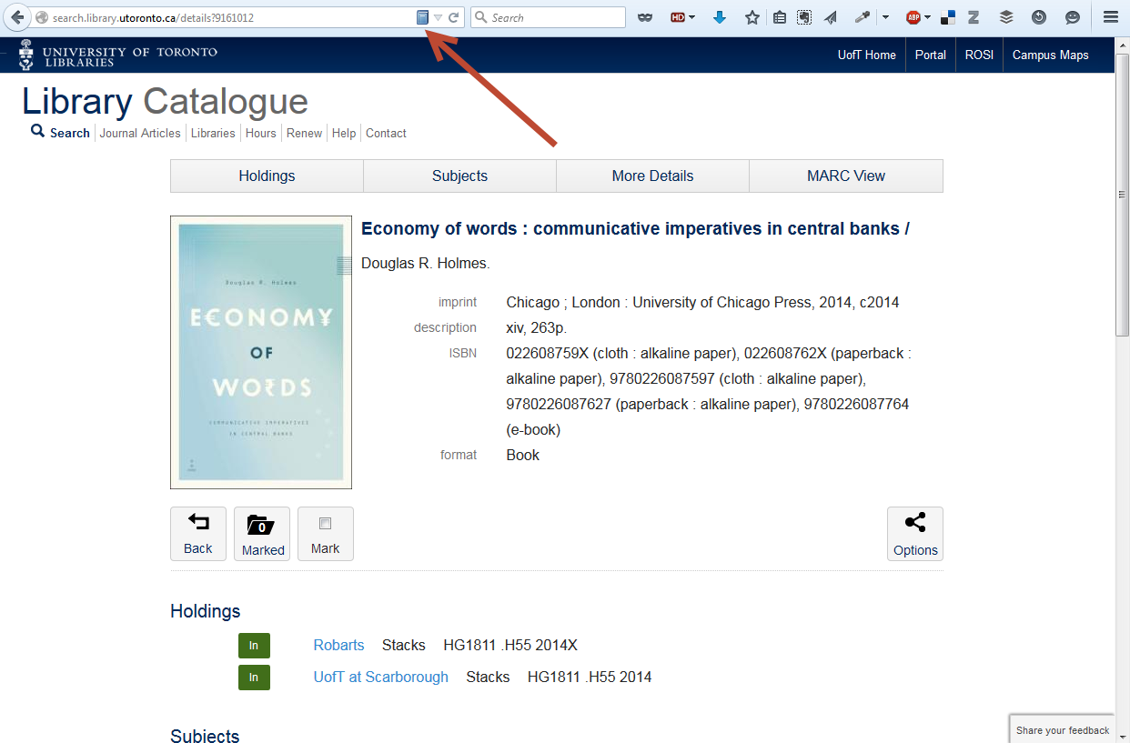
Configuration
Check that your browser has the Zotero Add-On installed:

Slide 8
Capturing
Two main scenarios
  Start with the library catalogue
    Capture the reference
    Attach the file (PDF, etc.) to the reference
  Start with a file (PDF, etc.)
    Upload the file into Zotero
    Create or look up the reference for that file

Slide 9
Capturing
Personal preference… but useful:
  “Rename file from parent metadata”
OCR your files to make it easy for Zotero to look up what they are
I capture edited collections as books first, then use “Duplicate item” to create a copy, which I convert to reference type “Book Section” for individual papers/chapters

Slide 10
Managing
Collections
Saved Searches
Managing duplicates
Managing unfiled items
Advanced Search
Exporting/importing from other tools

Slide 11

Writing – Microsoft Word
Word plugin adds new tools into Word
  In Add-ins tab in Windows
  Free-floating on the Mac
Insert a citation
Remove field codes (once you’re done!)
Edit the citation
Select citation/ bibliography style
Insert bibliography
Refresh Zotero connection
Edit the bibliography

Slide 12
Writing – Other ways to insert
Quick & dirty (e.g. for emails): Grab a Zotero entry in Zotero and drag it into any text field anywhere – instant reference!
RTF Scan: Type specially-formatted text codes into any word processor or text editor, then ‘scan’ the document through Zotero and have it replace the codes with proper citations/ bibliography (read the manual).

Slide 13
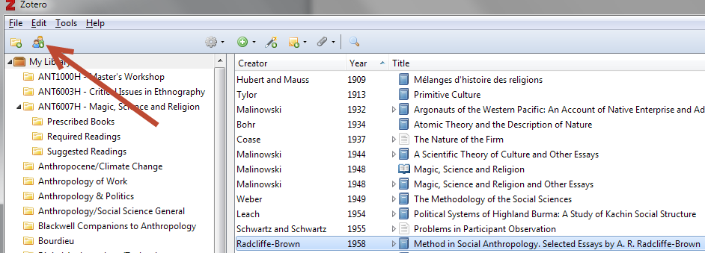
Sharing with others
Create a new Group
Takes you to Zotero website
Log in
Create new group there & it shows up at the bottom of your Zotero standalone
Start sharing
Be aware that someone’s storage is being used (and 300MB doesn’t go far if you’re storing PDFs)

Slide 14
Shortcomings and remedies
Anonymous, pseudonymous works (not clear, haven’t tested)
Reprints/modern editions – more than one date (Darwin [1859] 1964) (Chicago Style Manual 16th Ed., 15.38)
  There might be a workaround…

Slide 15

Questions?

